Slide 1
Healthcare stroke data analysis
Use machine learning to predict whether a patient is likely to get stroke
01
Data Clean
02
Visualization
03
Modeling
04
Conclusions
Data source: kaggle.com - Stroke Prediction Dataset

Slide 2
Data Clean
Columns:
id
gender
age
hypertension
heart_disease
ever_married
work_type
Residence_type
avg_glucose_level
bmi
smoking_status
stroke
Delete ‘Other’ in ‘gender’
Delete 201 missing values in ‘bmi’

Slide 3
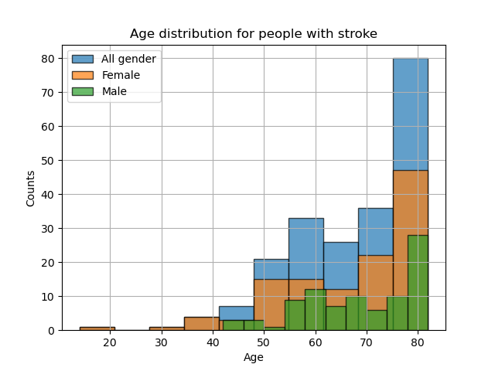
EDA

Slide 4
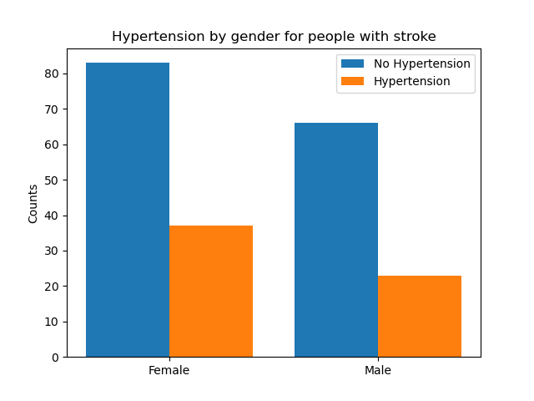
EDA

Slide 5
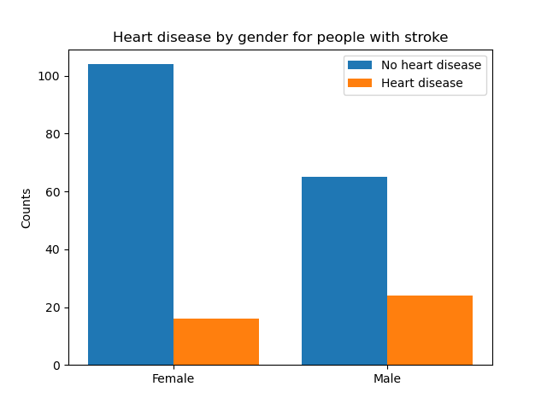
EDA

Slide 6
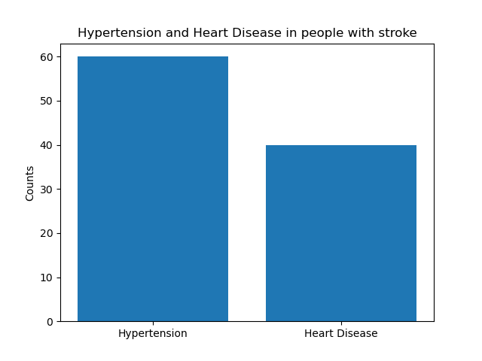
EDA

Slide 7
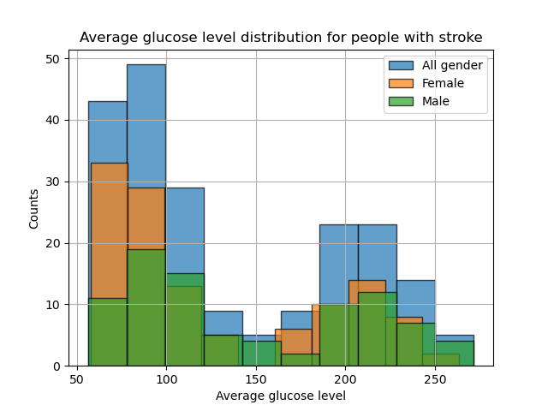
EDA

Slide 8
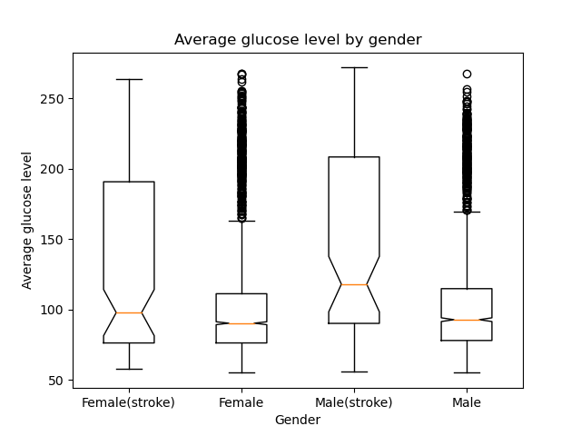
EDA

Slide 9
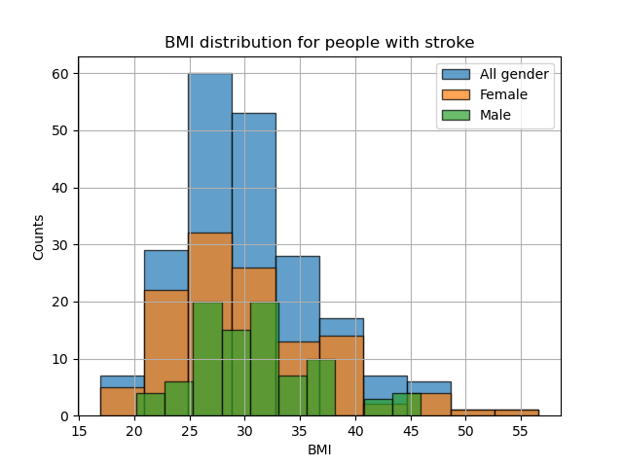
EDA

Slide 10
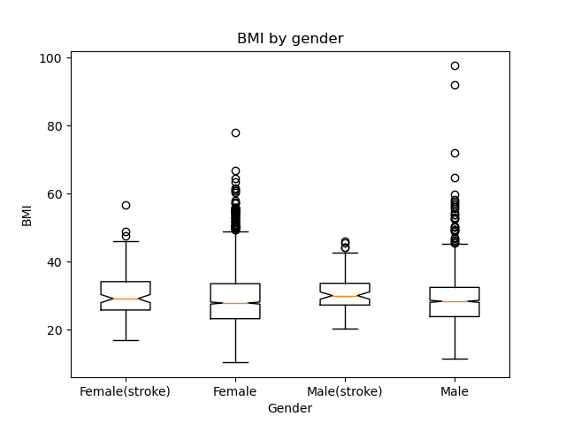
EDA

Slide 11
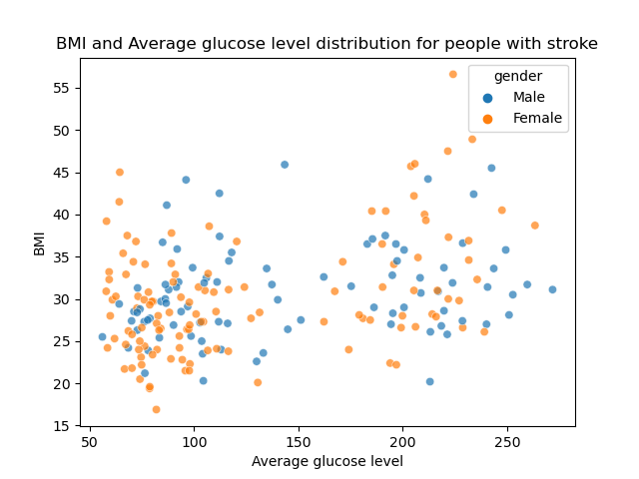
EDA

Slide 12
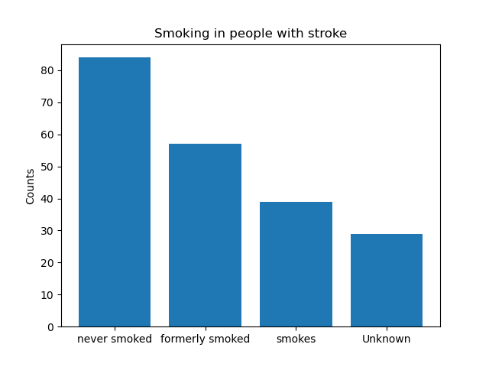
EDA

Slide 13
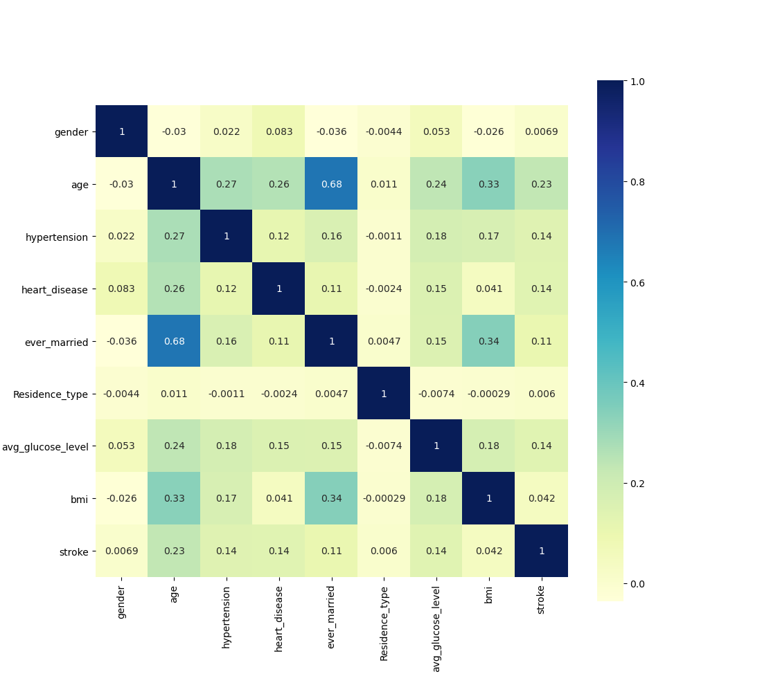
EDA

Slide 14
Modeling
Random Forest
GridSearchCV() to determine best parameters
‘max_depth': None, ‘min_samples_leaf: 1, 'min_samples_split': 4, 'n_estimators': 100
training score: 0.98
testing score: 0.96

Slide 15
Modeling
KNN with Pipeline
'n_neighbors': 14
Pipeline to keep code simple
training score: 0.96
testing score: 0.96

Slide 16
Modeling
Logistic Regression with Pipeline
Pipeline to keep code simple
training score: 0.96
testing score: 0.96

Slide 17
Modeling
Gradient Boosting
training score: 0.97
testing score: 0.95

Slide 18
Conclusions
Final Model
Important Features
Age
Hypertension
Heart disease
Average glucose level
Random Forest
Best training score: 0.98
Best testing score: 0.96

